Slide 1
Personal To-Do List Application
A simple, file-based task manager
Author: Shaunak Pandya
Date: 30 July 2025

Slide 2
Problem Statement
Modern life demands juggling work, home, and personal goals. People forget tasks or lose track in scattered notes.
Existing apps often require complex setups or databases.
We need a lightweight, easy-to-use solution that runs locally.

Slide 3
Objectives
Let users create, view, edit, and delete tasks. Support categorization (Work, Personal, Urgent, etc.).
Persist data without a full database—just a JSON file.
Provide clear, interactive command-line prompts.

Slide 4
Architecture
CLI Interface: Text-based menu driven by Python. Data Storage: A single tasks.json file in project folder.
Modular Code:
Task class for task data
Functions for I/O and user interaction

Slide 5
Data Model
Task Class Fields:
title (string)
description (string)
category (string)
created_at (ISO timestamp)
completed (boolean)
JSON Structure Example:
"title": "Buy groceries",
"description": "Milk, eggs, bread",
"category": "Personal",
"created_at": "2025-07-30T22:00:00",
"completed": false

Slide 6
Adding Tasks
User selects “Add Task” from menu. Prompt sequence:
Title
Description
Category (default “General”)
Application stamps current datetime and saves immediately.

Slide 7
Viewing & Managing Tasks
View Tasks lists each with:
Index number
✔ or ✖ status icon
Title, category, creation date
Easy scan to see pending vs. completed items.

Slide 8
Editing & Deleting
Edit Task:
Select by number
Leave fields blank to keep originals
Update title, description, or category
Delete Task:
Confirm removal by selecting task number
Immediate save to JSON

Slide 9
Persistence
Load on Start: Reads tasks.json (if exists) into memory. Save on Change: Writes entire task list back to tasks.json.
Fault-tolerant: creates file if missing, handles invalid JSON

Slide 10
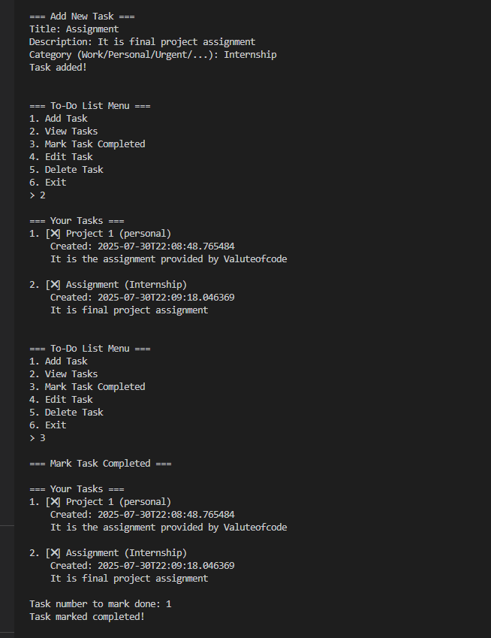
Demo 1

Slide 11
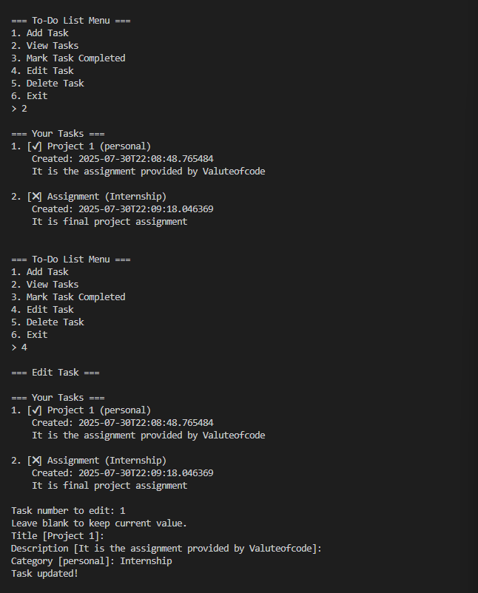
Demo 2

Slide 12
Thank You

